Slide 1


DEV CHALLENGE PRESENTATION
Guillermo Grajales

Slide 2

AGENDA
THE PROBLEM
DESIGN & DEVELOPMENT
ARCHITECTURAL DECISIONS
THE SEARCH ENGINE
KEY RESULTS & FINDINGS
FUTURE ENHANCEMENTS

Slide 3

SEMANTIC SEARCH WITH AWS AND NODE.JS

Slide 4

THE PROBLEM
Having a doctor’s name is required to find the best matching results of professionals in the United States by leveraging the National Provider Identifier (NPI) registry.
The solution must consider possible misspellings as well as proper display of results with sorting and filtering capabilities.

Slide 5





DESIGN & DEVELOPMENT
Tooling
Choosing the appropriate tooling for the app:
Serverless Framework
SAM CLI
Cloudformation
Jetbrains AI Assistant & ChatGPT
Backend
Much research was required to accomplish the expected results for the search. Key steps involved:
AWS Lambda implementation and integration with API Gateway
Search mechanisms and libraries (fuse.js, elastic search)
What model to use (GloVe, word2vec, tensorflow)
Pagination control
Frontend
For the UI part of the application, the following considerations were taken:
Next.js framework (React)
Material UI & Tailwind CSS for styling
Built-in fetch for HTTP requests
Usage of Material components for fast shipping
<TableComponent />
<OutlinedInput />
vs

Slide 6

ARCHITECTURAL DECISIONS
Aws RESOURCES

Slide 7

KEY COMPONENTS
AWS Lambda Function: A lambda function was selected as it is easier to implement and deploy than a whole EC2 container. It required Image package due to the usage of tensor-flow model.
AWS API Gateway: The gateway will handle the request and response for our application as well as triggering the right lambda handler based on the HTTP request path.
AWS ElasticSearch: The search engine that allows us to index data and perform complex search queries, including searches with embeddings, which is a key piece to getting accurate semantic results.
AWS Amplify: The host of the web application. It will handle deployments and server infrastructure automatically. It integrates with GitHub for quick deploys.

Slide 8
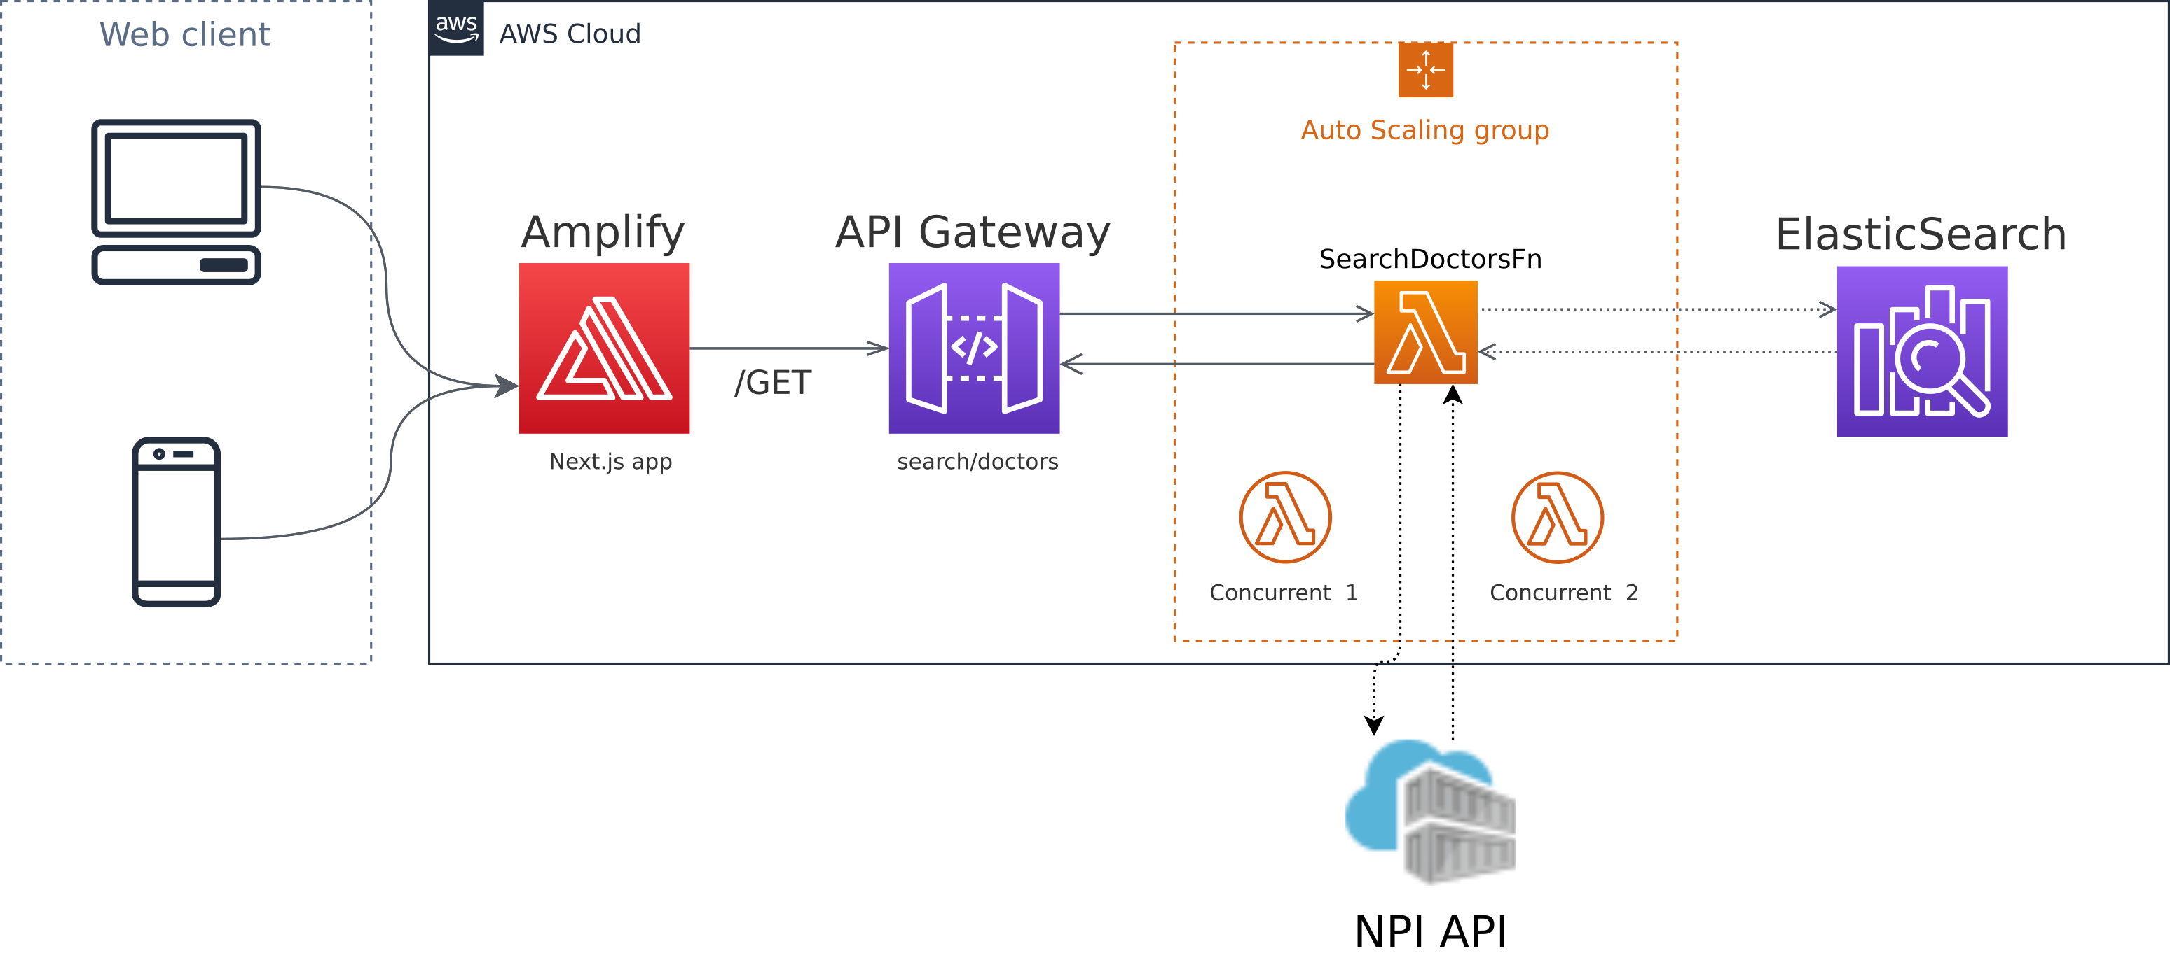
ARCHITECTURE DIAGRAM

Slide 9
THE SEARCH ENGINE
The chosen approach to solve the search problem was to rely on the ElasticSearch library using embeddings taken from a ML model.
ElasticSearch vs. Amazon Open Search
Initially, I used ElasticSearch with a script_score search having the cosine similarity as the backed function to find the score for the results.
Unfortunately, the Amazon Open Search does not support such functionality and a different approach with k-NN algorithm was chosen.
Matching and sorting
One of the advantages of using ElasticSearch is that you can perform a specific search query and it will automatically find the matches in the indexed data and sort the results based on the score.
SEARCH | FOUND RESULT | SCORE
Sam Wright | Sam Wright | 1
 | Samuel Wright | 0.8008
 | Samantha Wright | 0.7045
 | Samantha Grant | 0.6325
 | Samantha Perkins | 0.5588
A sample piece of the search engine results for Sam Wright with their given score

Slide 10
KEY RESULTS & FINDINGS
Fully automated deployment of both the backend and frontend applications. One relying on SAM CLI and the other on Amplify.
All the resources of the backend were defined in the SAM Template enabling easier maintainability and scalability, and permissions management.
The semantic search was successfully implemented with OpenSearch which yields relevant results based on a doctor name.
The website was created to allow users to search for doctors with ease, narrow by state, and sort results.
The fuzzy search is good to find related names but is not suitable to catch misspellings.
The Fuse.js library might be useful for lightweight fuzzy searches.
Amazon Open Search has greatly differed from the original ElasticSearch and some functionalities are not be interchangeable.
Open search supports ML models that may be used for semantic search. This could be used to enhance the current implementation.

Slide 11
FUTURE IMPROVEMENTS
Use a model from Elasticsearch (Opensearch) to avoid loading a model in Node.Js, thus reducing tremendously the loading times.
Add rate limit to avoid abuse.
Add different filters in the UI such as specialty and city.
Structure parallel requests in the frontend to reduce the overall search time.

Slide 12

THANK YOU
Guillermo Grajales
+57 318 7252702
guillo.grajales@gmail.com

